Slide 1
Building Intelligent Systems James Harland, School of CS & IT

Slide 2
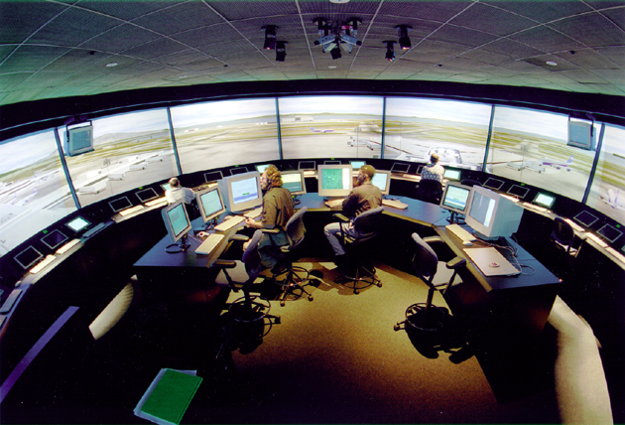
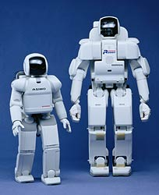
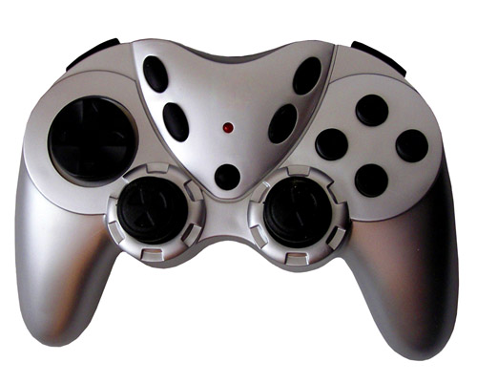
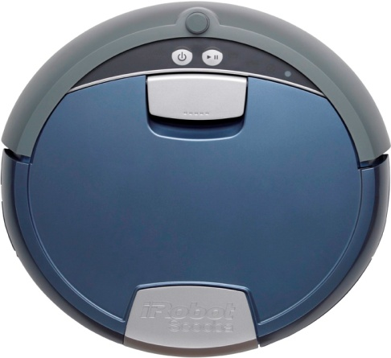
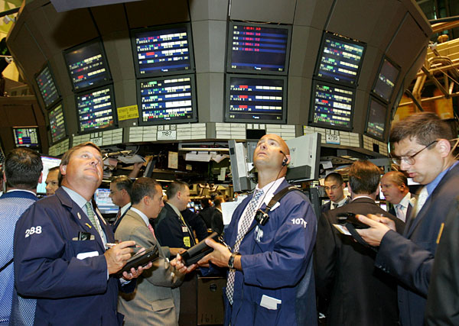
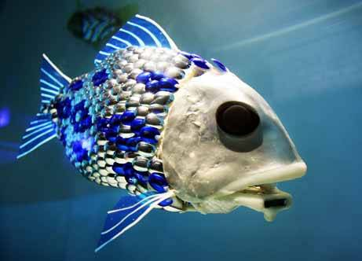
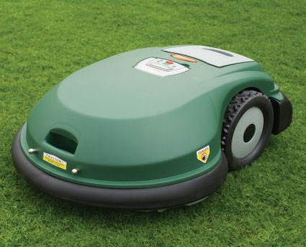

Slide 3
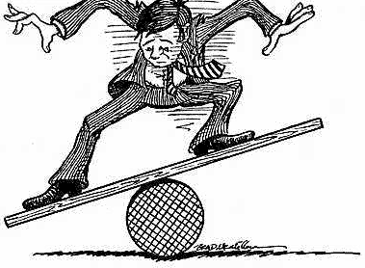
Why do we need Intelligent Systems?
New York Stock Exchange
33% of shares (by volume) traded by machines
40% of shares (by value) traded by machines
Needs fast response time

Slide 4
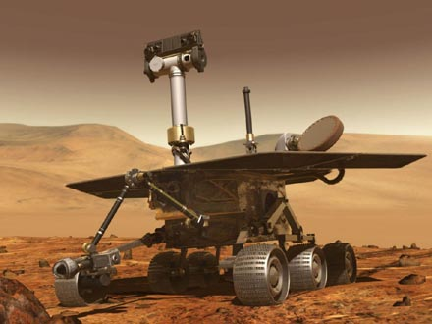
Why do we need Intelligent Systems?
The Robots are coming! The Robots are coming!”
Mars Rover
Home systems – vacuum, lawn mower, gutter cleaner
Military systems --- mine clearance, sensing, weapons control, autonomous vehicles, …
Sensor networks
Exoskeletons and artificial limbs
Rescue robots
Fish, birds, dogs, insects, …
…

Slide 5
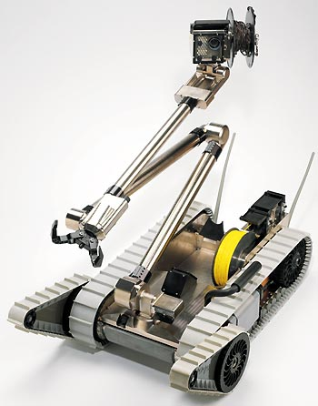
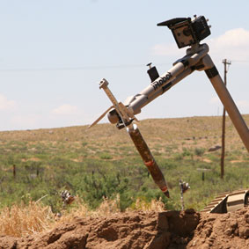
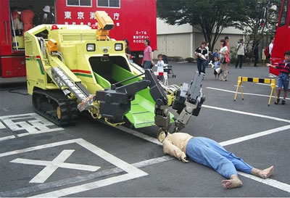
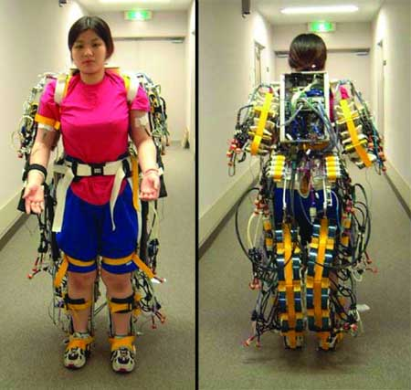
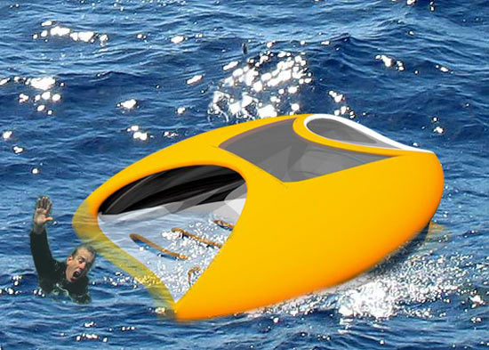
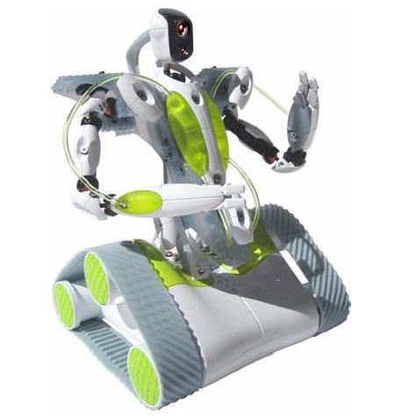
Robots

Slide 6
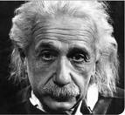
What is Intelligence?
talk | “Hello! How are you today. Could I please have a coffee?”
hear | Interpret “er… so.. um… as I was saying, what? No! Coffee please!”
read | Interpret “Time flies like an arrow. Fruit flies like a banana.”
think | “Low on fuel, it’s getting dark, no clue where I am … Hmmmm….”
act | Pick things up, move them, walk, build things, …
see | Distinguish moving objects from static ones, colours, textures, …
adapt | This isn’t working, so let’s try something else …
paint | Make judgements about what is pleasing and what is not

Slide 7
Intelligent Systems in CS & IT
Agent oriented programming
Software that observes, thinks, acts and reacts
Natural language processing and generation
Software that can have a dialogue with humans
Computational reasoning
Software that can work out what to do
Machine learning
Software than can analyse, adapt and be trained
Evolved Art
Artistic collaboration with School of Media and Communication
Interactive Toys
Collaboration with XSiVE on toys which interact with children and grow with them

Slide 8
Questions?

